Slide 1
Midterm Progress Report By: Justin Joseph

Slide 2
Recap
What is my project?
- Creating an app to integrate different streaming services (different from Project I)
Why did I choose this topic?
- I got annoyed that I had to use different streaming services to listen to certain songs.

Slide 3
Features (ideally)
Listening to songs across streaming services
Creating playlists with the same songs
Tracking listening statistics ***

Slide 4

Current progress?

Slide 5

Documentation
System Architecture:
Creating application for Android devices
Using Android Studio for development
Code in Java and UI in xml
Data and component design after development
Mostly because I am figuring out what I need as I develop
Created rough UI sketches (MS Paint)

Slide 6
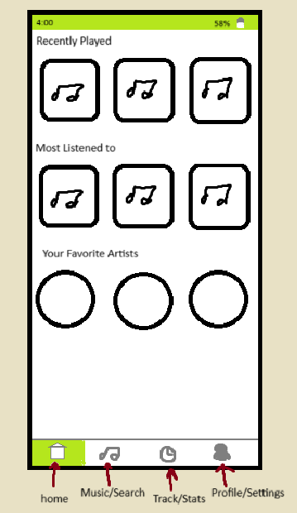
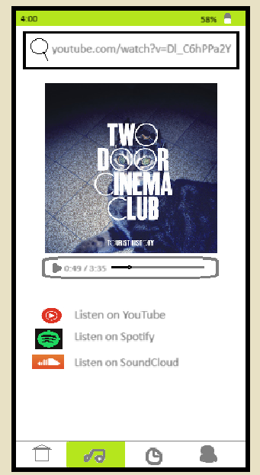
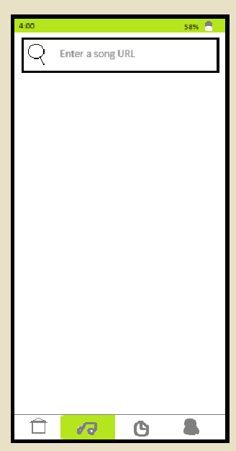
UI Sketches

Slide 7
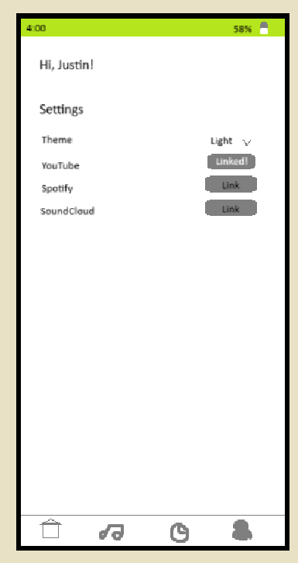
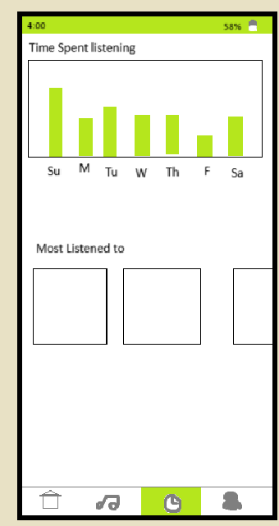
UI Sketches Cont.

Slide 8

Application
Basic UI
Navigation bar with empty fragments
Song fragment to display song information
Currently developing
Basic playlist functionality
Adding songs to playlist by URL
Search bar to find songs
Ability to listen to songs*

Slide 9
Issues
Actually playing music in app
Placeholder solution is to redirect user to browser
Not ideal nor clean solution
Spotify has an Android SDK (more research needed)
YouTube is compatible with WebView but not flexible
Tracking listening time
YouTube and Spotify don’t support this in API
Manually tracking time is impossible with placeholder solution
This is also a lower priority feature

Slide 10
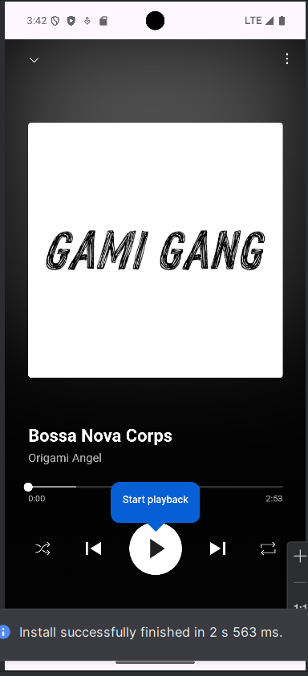
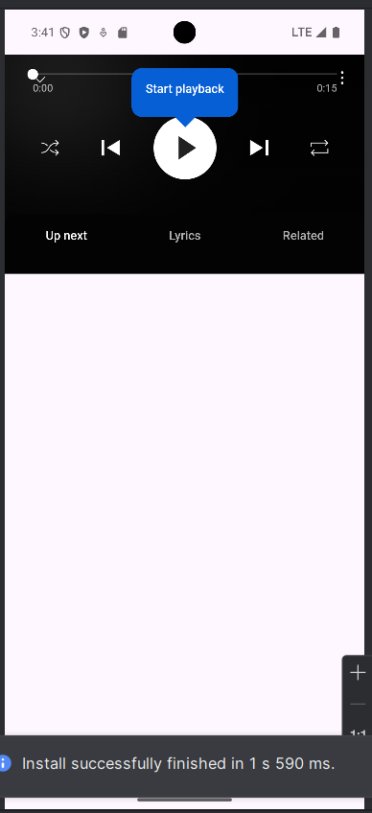
Issues cont.
Full display width Webview
Compressed display width Webview

Slide 11
Personal Evaluation
Behind on progress
Spent too much time aimlessly planning
Should have spent more time developing
Find and implement placeholder solutions
Consider complete solutions afterwards

Slide 12
Final tips & takeaways
Consistent rehearsal
Strengthen your familiarity
Refine delivery style
Pacing, tone, and emphasis
Timing and transitions
Aim for seamless, professional delivery
Practice audience
Enlist colleagues to listen & provide feedback
Seek feedback
Reflect on performance
Explore new techniques
Set personal goals
Iterate and adapt

Slide 13
Thank you
Brita Tamm
502-555-0152
brita@firstupconsultants.com
www.firstupconsultants.com

